Slide 1


PROP’21 Project Presentation and Demonstration On “Story Simulation – Thirsty Crow”
Students:
RACHANAA M RAGHUTHAMA: 1RN18C078
RIDHA P: 1RN18CS086
VARNIKA BAGARIA: 1RN18CS115
Guide:
NAME: Mamatha Jajur Mam
DESIGNATION: Assistant Professor
Department of Computer Science and Engineering
(NBA Accredited for academic years 2018-19, 2019-20, 2020-21)
RNS Institute of Technology
Dr.Vishnuvardan Road, Channasandra, Bengaluru-560 098
2020-21

Slide 2
OUTLINE
Introduction
Mini-world- problem statement
User Interactions
Snapshots
Tools and Technologies

Slide 3
Introduction- relevance of the topic
This project is the creative implementation of ‘Story Simulation – Thirsty Crow’ using a set of OpenGL functions. This consists of the following scenes:
The first scene is of a thirsty crow flying on a sunny day.
This will be followed by him finding a pot near the house which has very low level of water, and him striking upon an idea.
This will be followed by him picking up some stones. This will concluded with moral of story
User interaction is provided by allowing the user to go to the next scene as well as picking up stones.
Water level in the pot can be seen by using the right click button.

Slide 4
User interaction and features
Keyboard event functions
Mouse event functions
Menu functions
Translation effects
Rotation effects
Draw polygons and fill area
Bit Map Character for text views

Slide 5
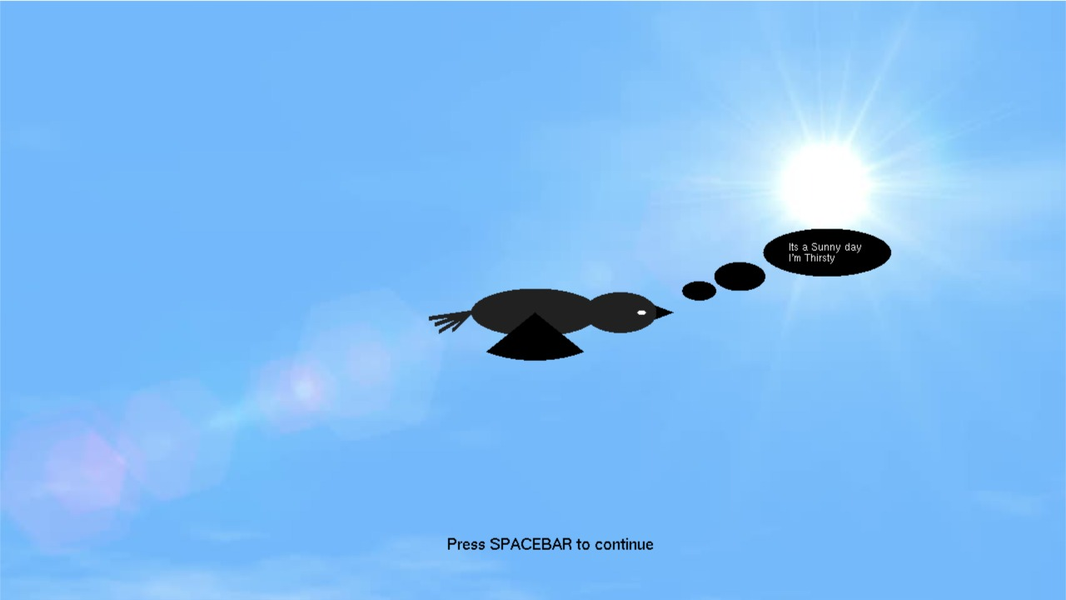
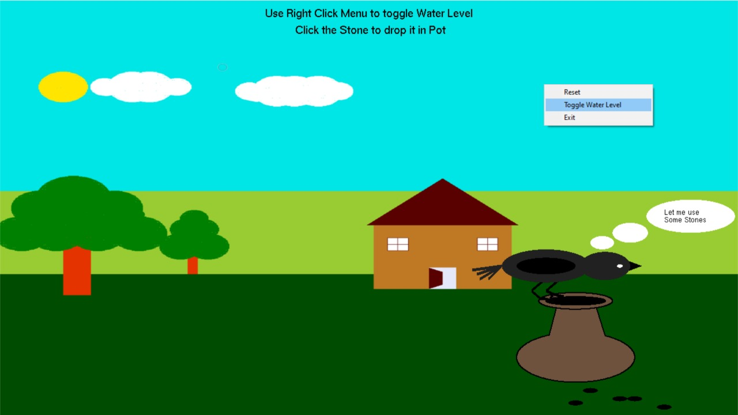
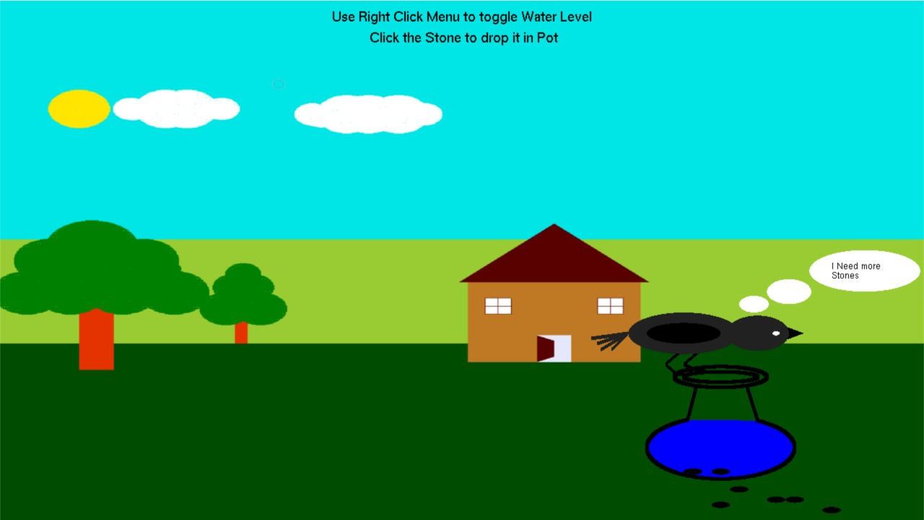
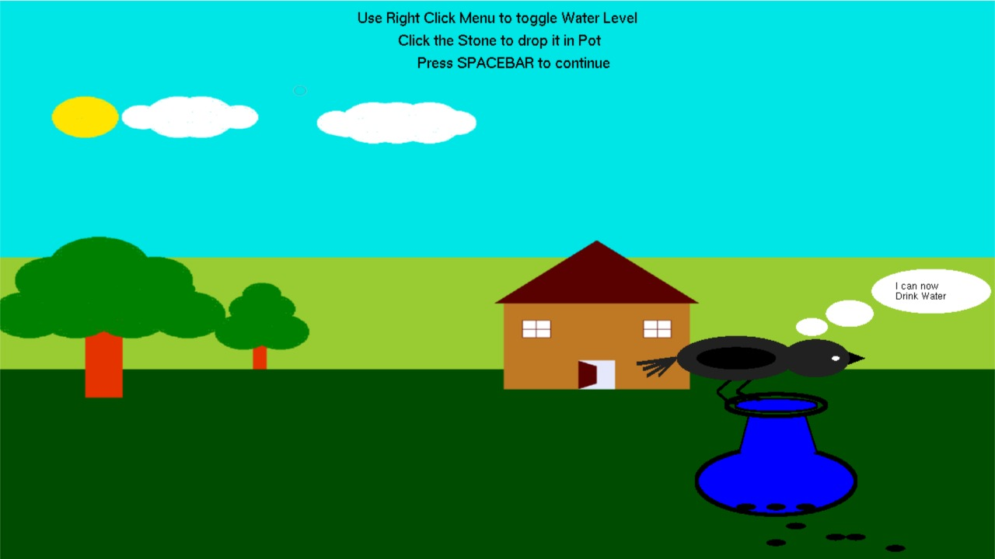
snapshots

Slide 6



Tools and technologies
Software Requirements:
Editor: Visual Studio 2019
Graphics library: GL/glut.h
C++ language
Operating System
OpenGL 2.0
Photoshop
Hardware Requirements:
RAM: 2GB (minimum)
Hard Disk (40 GB)
Mouse: 2-3 button
Monitor: 1024 x 768 display resolution

Slide 7
Thank you
Queries ??

